Slide 1
Synthesized Data Generation
——Using CGAN to generate synthesized data
Bike Fan, Jianfeng Chen

Slide 2
Catalogue
Task 1: Aggregate Statistics
Task 2: Machine Learning Predictor
Task 3: Synthesized Data Generation

Slide 3
Task 1: Aggregate Statistics
In this task, we aggregate user characteristics including
Age Group Distribution
Geographic Distribution
Device Usage
Engagement Patterns
Content Preferences
We compared the difference between users who clicked the ads and all users in order to get some meaningful insights.

Slide 4
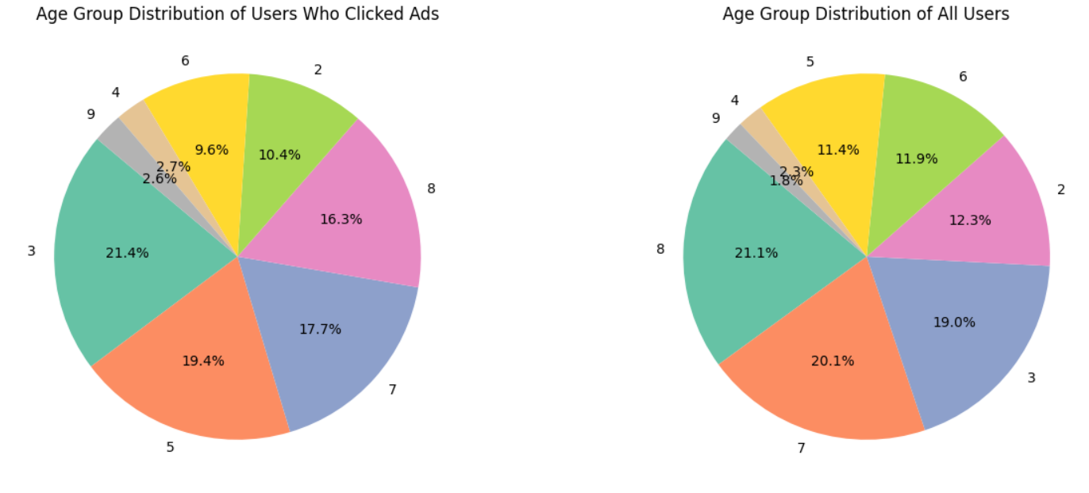
Task 1: Aggregate Statistics

Slide 5
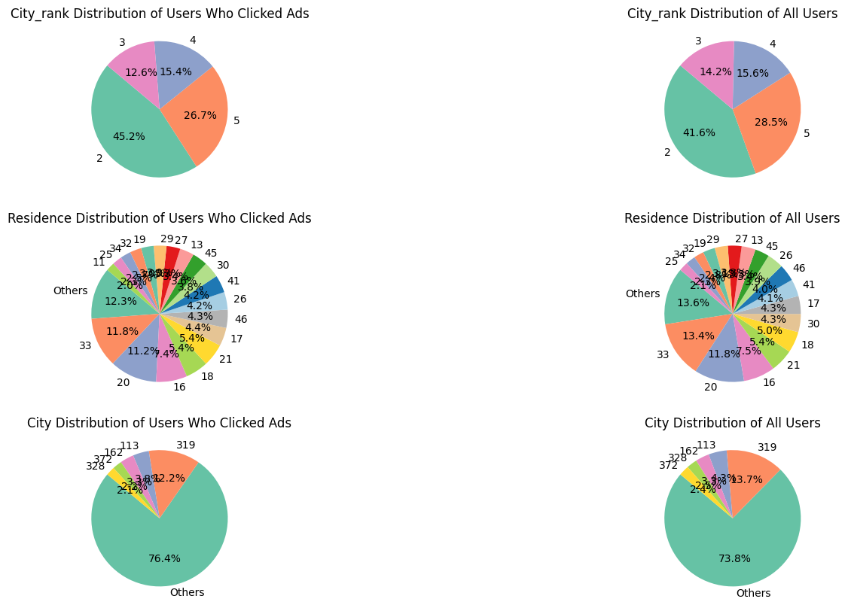
Task 1: Aggregate Statistics

Slide 6
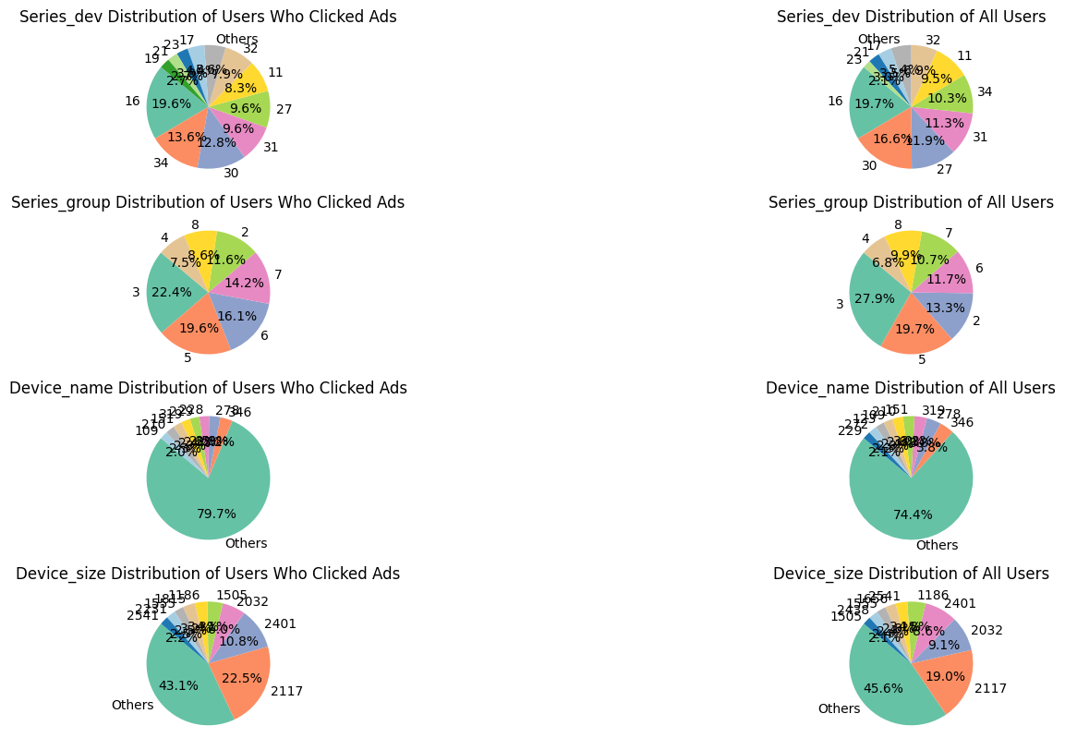
Task 1: Aggregate Statistics

Slide 7
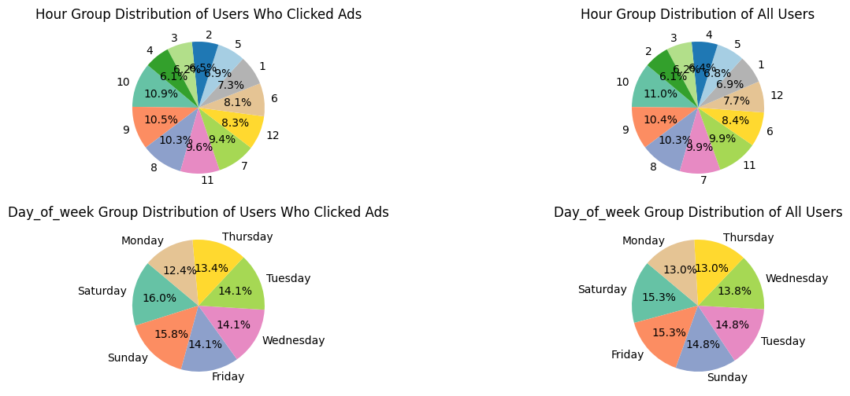
Task 1: Aggregate Statistics

Slide 8
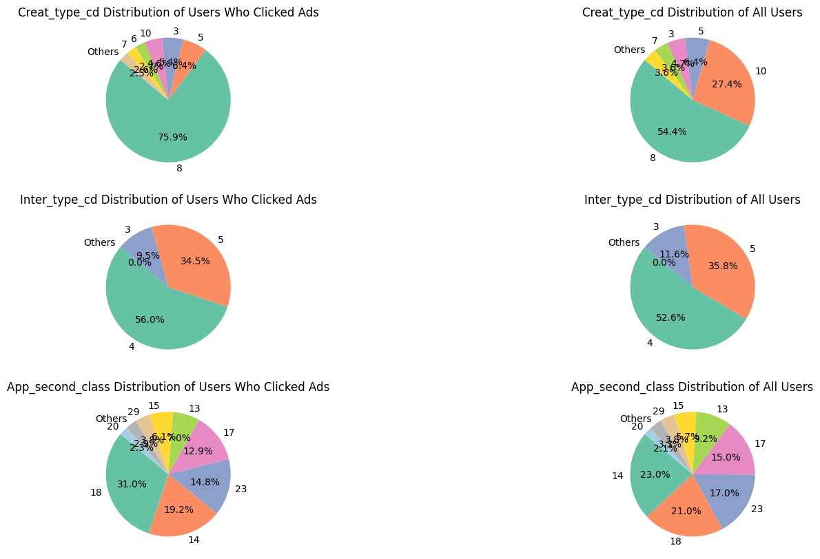
Task 1: Aggregate Statistics

Slide 9
Task 1 Conclusions
Uses who clicked the ads has a high proportion of adv_prim_id 1036, hispace_app_tags 43, lower proportion of hispace_app_tags 47, U_feedlifecycle 17 and less refresh time.
There's no obvious difference in the type between contents clicked and all contents.
Users prone to click create_type_cd 8, app_second class 18 more and create_type_cd 10, app_second class 14 less.
Uses who clicked the ads has a high proportion of series group 6, 7, lower proportion of series dev 34, 30, series group 3.
Uses who clicked the ads has a high proportion of city rank 2, lower proportion of residence 33.
Uses who clicked the ads has a high proportion of age 5, lower proportion of age 8.
Uses who clicked the ads has a high proportion of category 0.

Slide 10
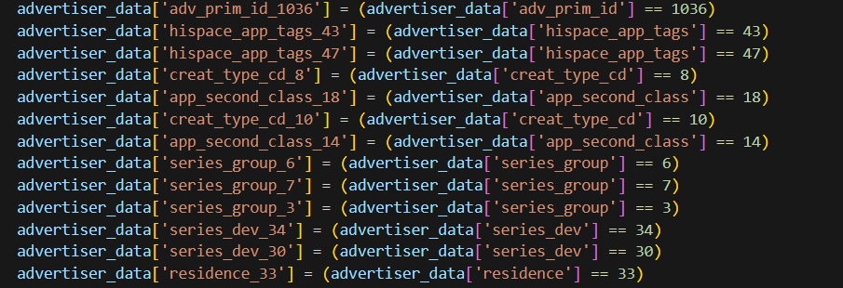
Task 2: Machine Learning Predictor
Because of the high dimensionality, We decided to use dummy variables with high difference between users who clicked the ads and all users based on the findings in task 1:

Slide 11
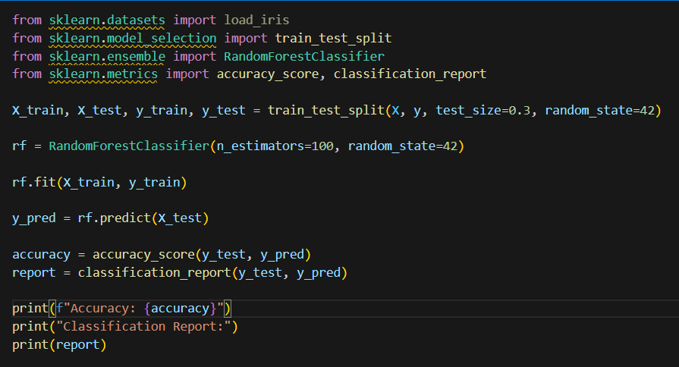
Task 2: Machine Learning Predictor
We adopted a Random Forest model to predict whether a user clicked the ads or not.

Slide 12
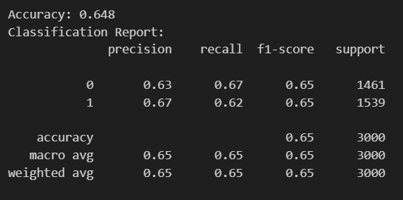
Task 2: Machine Learning Predictor

Slide 13
Task 3: Synthesized Data Generation
Before we used Conditional GAN model to generate synthesized data. We processed the data:
split data in list format
for id data(in string format), we transformed it into int lists using a dictionary, then we used an autoencoder to conduct dimensionality reduction
for timestamp data, we transformed it into int type which represents how mant minutes it is from the earliest time.
We also merged Advertiser Data and Publisher Data:
First, we grouped by the publisher data by user_id after choosing the suitable group function for each column.
Then we inner joined publisher data and advertiser data on user_id.

Slide 14
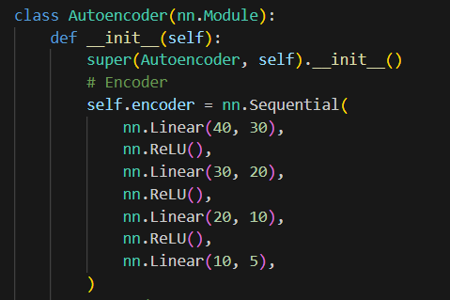
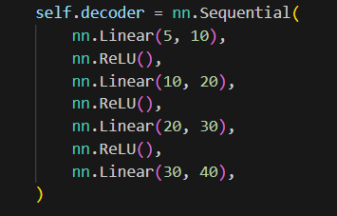
Task 3: Synthesized Data Generation
To handle id data in string format, we adopted Autoencoder model to conduct data dimensionality reduction.

Slide 15
Task 3: Synthesized Data Generation
After handling all data, we used Conditional GAN model to conduct synthesized data generation.
We used a CGAN(Conditional Generative Adversial Network) model to generate synthesized data
We used label as the condition in the model, for users with different labels are supposed to have different characteristics.
We also used spectral normalization the process the Discriminator to prevent it to be too strong for the Generator.

Slide 16
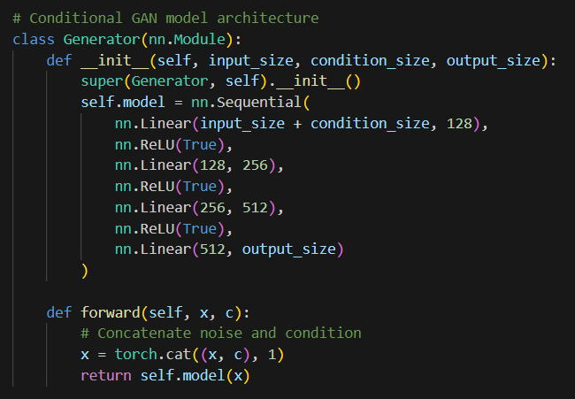
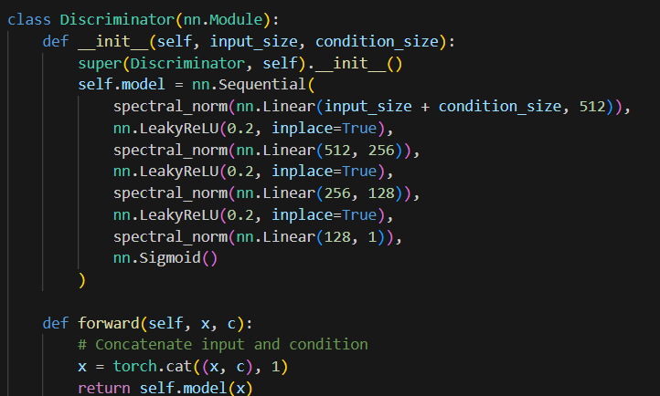
Task 3: Synthesized Data Generation

Slide 17
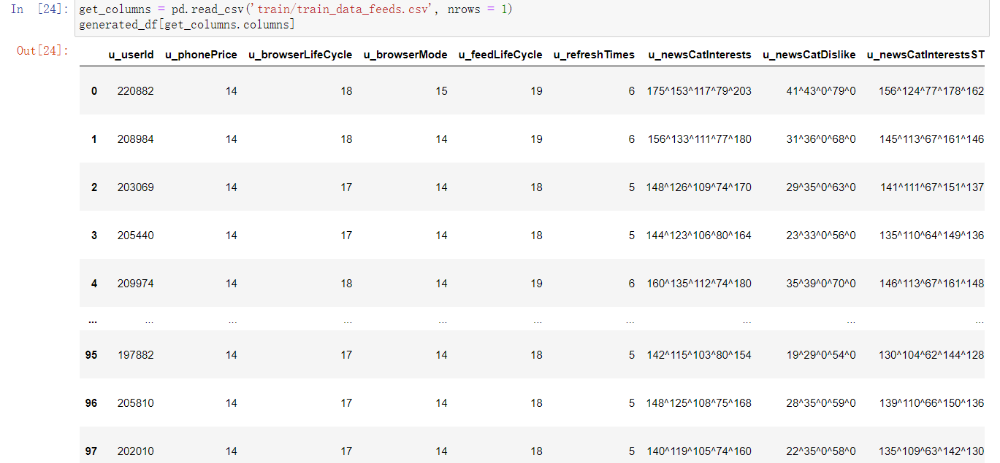
Task 3: Synthesized Data Generation

Slide 18
Thank you!

